Slide 1

FINAL YEAR RESEARCH PROJECT
Review-1 Presentation
[Placement pro +]
Supervised By: Prof. Venkatesh Dalei
Group No : 10
Name of the Student(s) with Regd. No :
Aditya Subhaditya (2241019558)
Sudhanshu Sinha(2241019539)
Vishal Kumar Singh(2241019527)
Khirod Kumar Patro(2241016312
Department of Computer Sc. and Engineering
Faculty of Engineering & Technology (ITER)
Siksha ‘O’ Anusandhan (Deemed to be) University
Bhubaneswar, Odisha
1

Slide 2
Presentation Outline
Problem Statement & Motivations
Problem Statement
Motivations
Literature Review
Existing Solutions & Limitations
Proposed Methodology & Approach
Key Components/Modules & Algorithms Used
Dataset & Tools/Technologies
Work Done So Far (Implementation Progress)
Preliminary Results (if any)
Future Work Plan
References
2

Slide 3
Introduction & Research Motivation
Project Overview:
Placement.OS is an advanced AI-powered Placement Preparation System. It utilizes a Neuro-Symbolic Artificial Intelligence architecture to algorithmically evaluate student skills, predict deterministic placement probabilities, and identify specific knowledge gaps.
Why This Research Idea?
Modern technical education frequently struggles with academic-industry misalignment, where students graduate lacking the dynamic skills strictly required by top-tier tech companies. We initiated this research to mathematically bridge that gap. Rather than relying on generic educational syllabi, our system dynamically generates fully personalized, data-driven 12-week learning roadmaps.

Slide 4
Problem Statement
Generic Preparation: Existing platforms offer one-size-fits-all roadmaps, ignoring base skills.
Lack of Logical Progression in AI: Standard LLMs hallucinate learning paths, failing to enforce prerequisites (e.g., trying to teach ML before Python basics).
Siloed Systems: A fundamental disconnect exists between ML-based prediction models and actionable GenAI curriculums.
Limited Feedback Loops: Most platforms lack continuous assessment and adaptive feedback mechanisms, resulting in static learning paths that don’t evolve based on a learner’s progress, mistakes, or changing goals.
3

Slide 5
Motivations
Personalized Learning: Empower students with tailored 12-week roadmaps that react dynamically to their current skills.
Precision over Hallucination: A Neuro-Symbolic approach guarantees logically sound, executable study plans without AI hallucination.
Holistic Solution: Bridge statistical prediction (likelihood of placement) with intelligent recommendation (how to improve).
Continuous Adaptation: Integrate real-time performance tracking and feedback loops to constantly refine the learning path, ensuring it evolves with the student’s progress, strengths, and weaknesses.
4

Slide 6
Literature Review
Table 1:Summary of Existing Approaches and Research Limitations
[Example Table for Reference]
S. No. | Author & Year | Methods/Techniques Used | Dataset Used | Research Outcomes | Findings
Example 1 | Smith et al. (2022) | Feature Extraction: Ensemble Learning Classification: Random Forest | UCI Repository, Python | Accuracy: 92–95% F1 Score: 0.91 AUC: 0.93 Recall: 0.90 | High accuracy with structured data; stable and reliable performance but limited scalability
Example 2 | Kumar & Patel (2023) | Feature Extraction: CNN (Deep Learning) Classification: Convolutional Neural Network | Custom Dataset, TensorFlow/Keras | Accuracy: 90–93% F1 Score: 0.89 AUC: 0.91 Recall: 0.88 | Superior performance with automatic feature extraction; computationally expensive and requires large data
3
4
5

Slide 7
Research Gap & Improvements
The Gap: Current EdTech AI relies either entirely on rigid structural graphs or entirely on probabilistic language models.
Our Improvement: Bridging the gap using a customized Neuro-Symbolic architecture.
Neural Component (Semantic Understanding): Using sentence embeddings (SentenceTransformers) to semantically match a student's unstructured skills to the backend database.
Symbolic Component (Logical Constraints): Navigating a weighted Knowledge Graph (NetworkX) to enforce strict prerequisite traversal for the generated syllabus.
6

Slide 8
Proposed Solution & Architecture
Brain MRI d
Preprocessing
CNN-Based Feature Extraction & Selection
Attention Mechanism
Classification
Fig. 1: Workflow of the Proposed Model
[Example Figure for Reference]
Result Analysis
Final Output
7

Slide 9
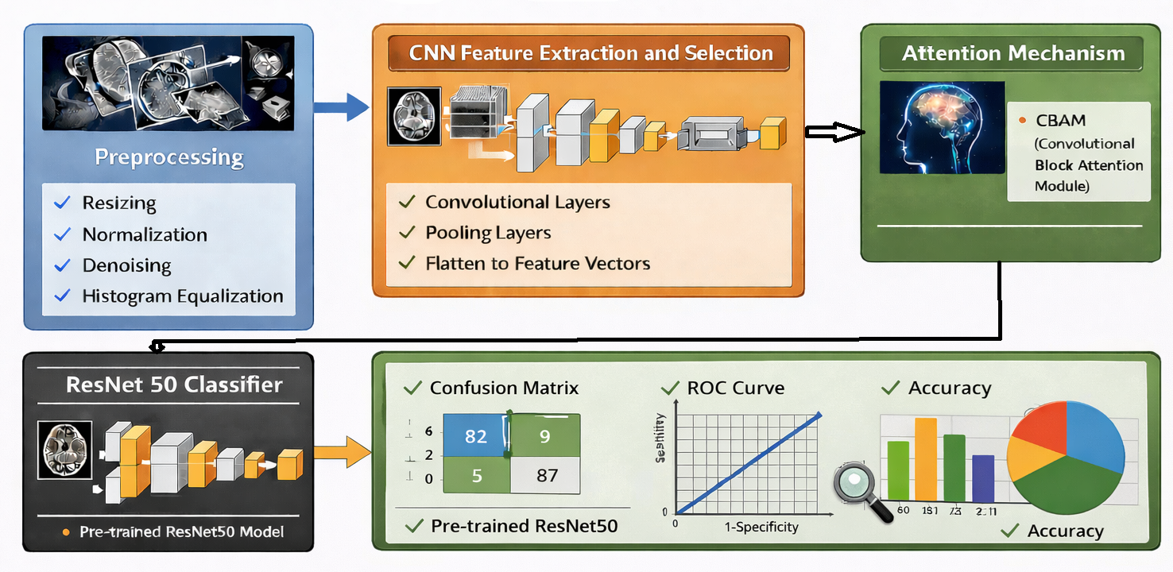
Proposed Solution & Architecture cont.
Fig. 2: Schematic Model Diagram of the Proposed Model
[Example Figure for Reference]
8

Slide 10

Application Architecture

Slide 11
Technology Stack
Frontend (Client-Side Rendering):
• Core: React 19 + TypeScript
• Compilation: Vite (esbuild)
• UI & Animation: Tailwind CSS + Framer Motion
• Visualizations: Recharts
Backend (Neuro-Symbolic Engine):
• Framework: Python Flask (RESTful API Ecosystem)
• Vector Search: Hugging Face sentence-transformers (all-MiniLM)
• Knowledge Graph Algorithmic Routing: NetworkX
• Data Handling: Scikit-learn, Numpy
Database Architecture:
• SQLAlchemy mapped to SQLite
Cloud Infrastructure:
• Frontend Hosting: Netlify Global Edge CDN
• Backend Engine: Hugging Face Spaces (Dockerized Container)

Slide 12
Dataset & Tools/Technologies
Datasets: Simulated historical student profiles (for ML scoring) and a custom Directed Acyclic Graph (DAG) for the CS Curriculum.
Frontend Application: Built with React, TypeScript, and Vite for performance.
Backend Architecture: FastAPI (Python) for rapid ML inference and routing.
AI/ML Stack:
SentenceTransformers (NLP Vectors)
NetworkX (Graph Theory)
Scikit-Learn (Predictive ML)
9

Slide 13
Progress in Implementation Plan & Methodology
System Skeleton: Initialized the full-stack architecture with functional React-FastAPI communication.
Predictive Engine: Successfully deployed the ML-driven placement prediction component calculating readiness percentiles.
Neuro-Symbolic Engine: Completely overhauled the backend API to parse skills through our custom semantic knowledge graph.
Frontend Integration: Designed a dynamic, interactive dashboard to display these roadmaps continuously.
10

Slide 14
Future Work Plan
Advanced State Tracking: Implement granular database tracking for students' weekly progress checks.
Dynamic Re-Routing: Develop the logic to auto-regenerate the remaining weeks of the roadmap if a student fails a milestone quiz.
Interactive Graph Visualizations: Render the prerequisite graph visually on the frontend.
Production Deployment: Containerize the FastAPI backend and deploy via standard cloud services.
11

Slide 15
References
[1] | A. Sharma, R. Kumar, and S. Das, “Deep learning-based brain tumor detection using MRI images,” IEEE Access, vol. 10, pp. 12345–12356, 2022.
[2] | P. Singh and M. Gupta, “Machine learning techniques for disease prediction,” International Journal of Medical Informatics, vol. 134, pp. 104–112, 2021.
[3] | S. Roy et al., “A hybrid CNN-LSTM model for medical image classification,” IEEE Transactions on Medical Imaging, vol. 39, no. 5, pp. 1400–1410, 2020.
[4] | K. Patel and N. Shah, “Transfer learning approach for image classification using VGG16,” Procedia Computer Science, vol. 167, pp. 197–206, 2022.
[5] | R. Das and A. Mishra, “EfficientNet-based model for disease detection,” Expert Systems with Applications, vol. 198, pp. 116–130, 2023.
[6]

Slide 16

13

